Slide 1

PSYLIQ- DIABETES PREDICTION ANALYSIS (SQL)
AMAN JHA
(DATA ANALYST INTERN)

Slide 2
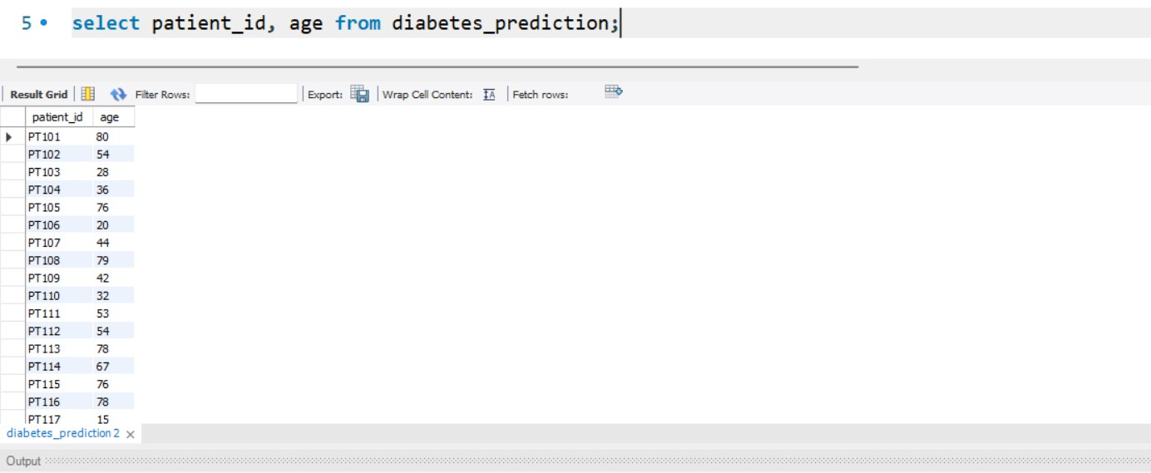
Retrieve the Patient_id and ages of all patients.

Slide 3
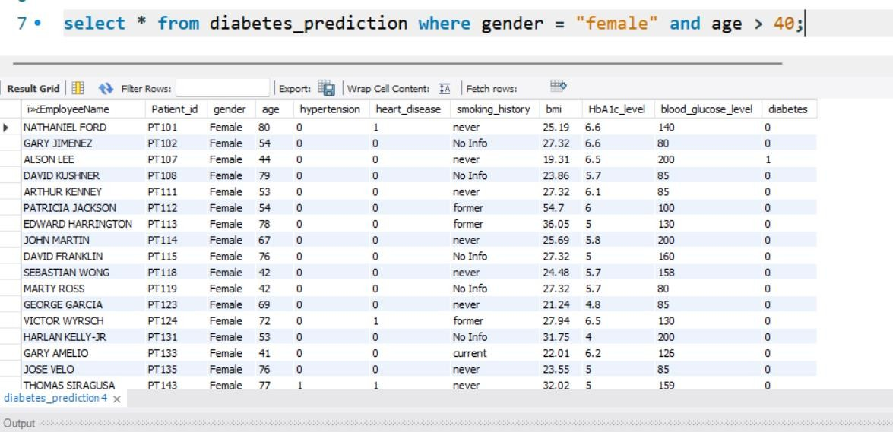
Select all female patients who are older than 40.

Slide 4
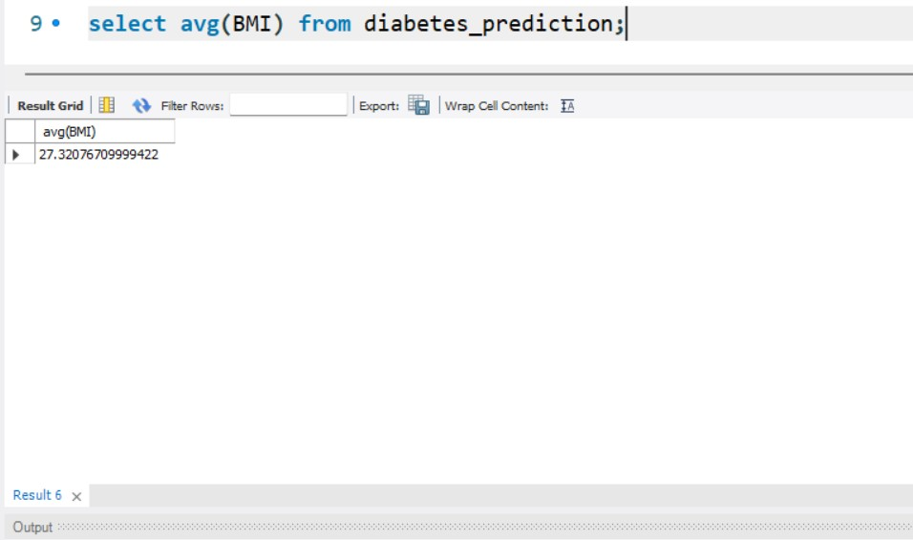
Calculate the average BMI of patients.

Slide 5
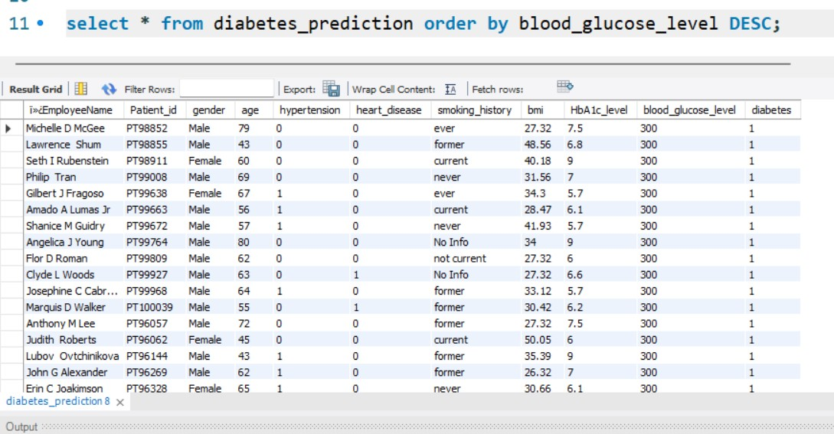
List patients in descending order of blood glucose levels.

Slide 6
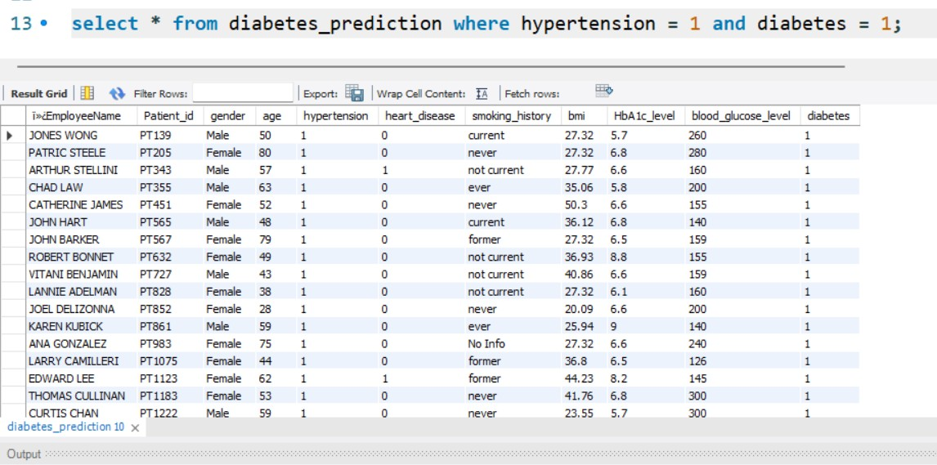
Find patients who have hypertension and diabetes.

Slide 7
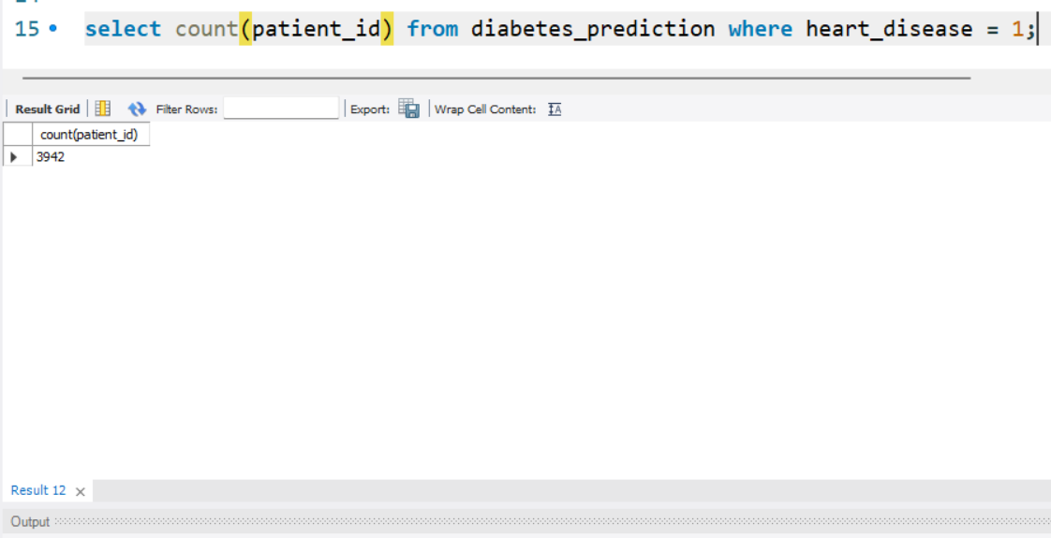
Determine the number of patients with heart disease.

Slide 8
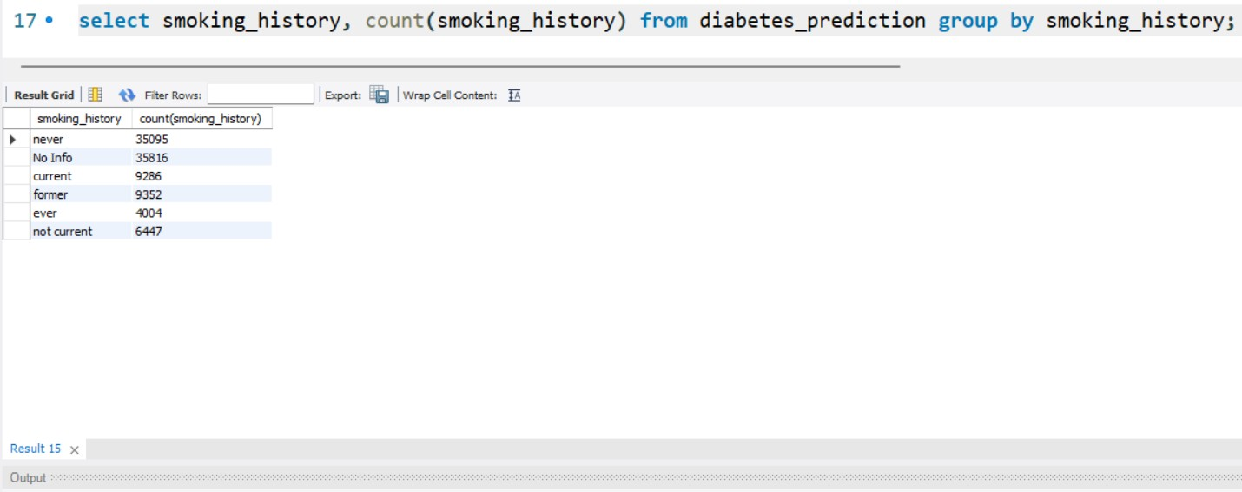
Group patients by smoking history and count how many smokers and non-smokers there are.

Slide 9
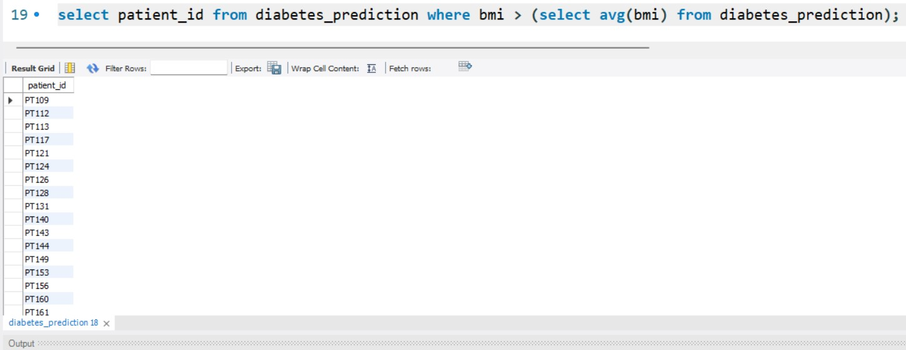
Retrieve the Patient_ids of patients who have a BMI greater than the average BMI.

Slide 10
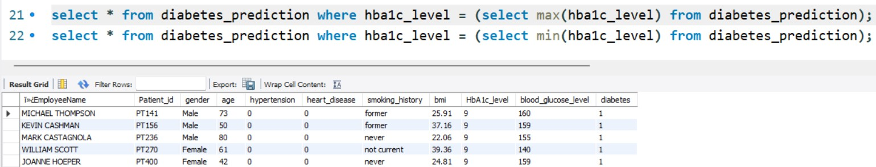
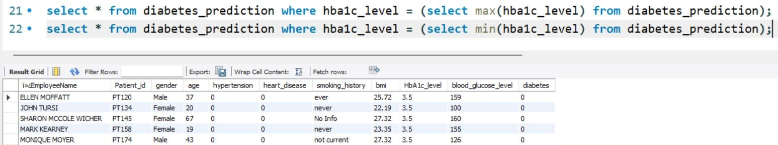
Find the patient with the highest HbA1c level and the patient with the lowest HbA1clevel

Slide 11
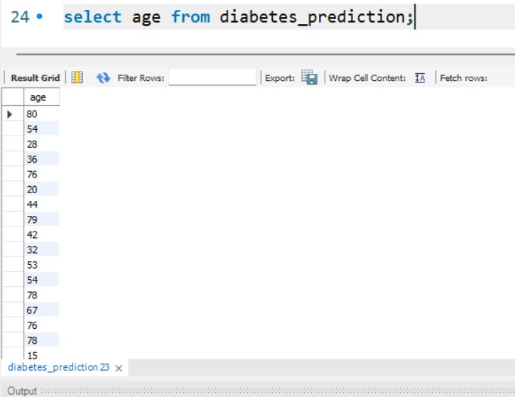
Calculate the age of patients in years (assuming the current date as of now

Slide 12
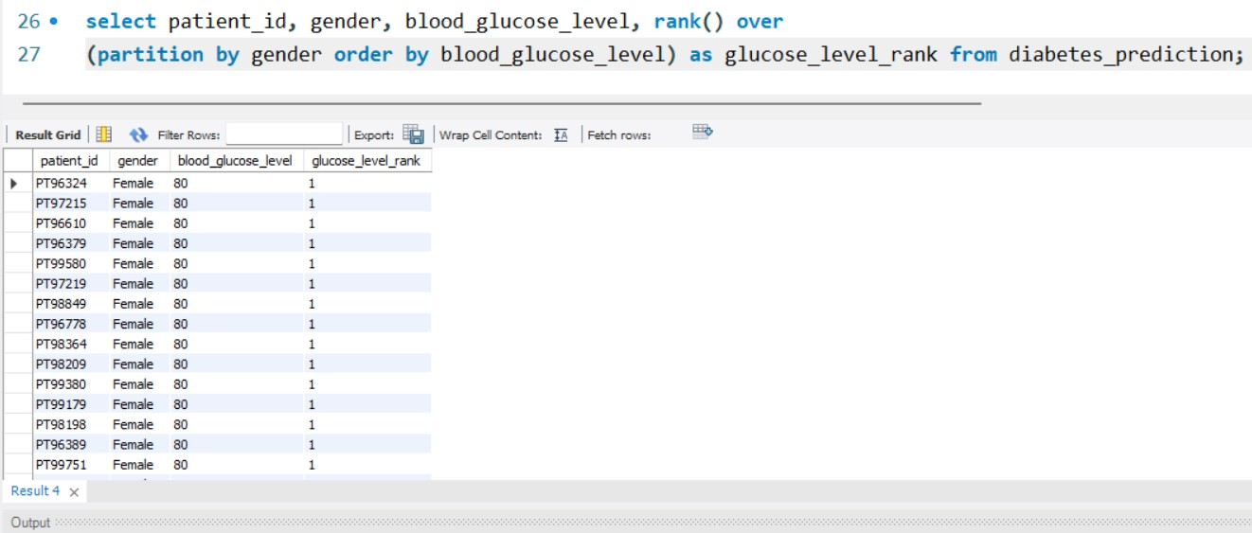
Rank patients by blood glucose level within each gender group

Slide 13
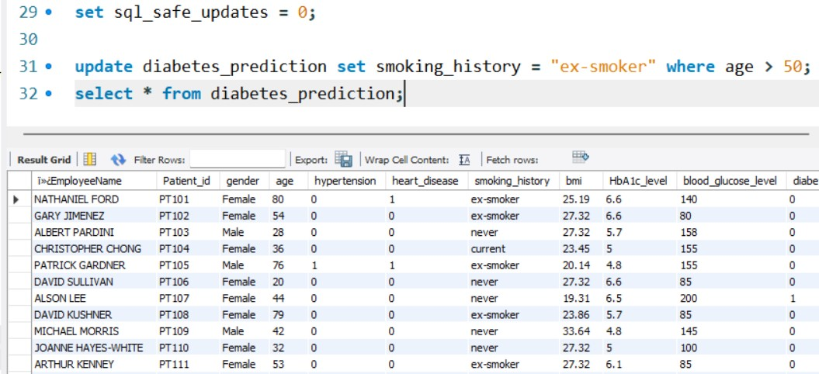
Update the smoking history of patients who are older than 50 to "Ex-smoker."

Slide 14
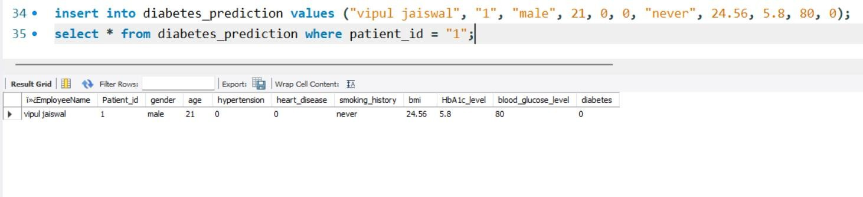
Insert a new patient into the database with sample data

Slide 15
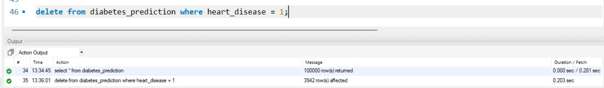
Delete all patients with heart disease from the database

Slide 16
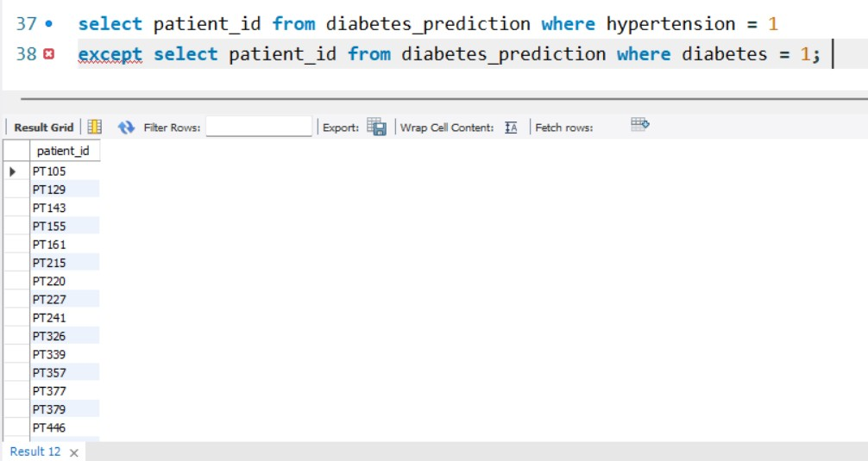
Find patients who have hypertension but not diabetes using the EXCEPT operator.

Slide 17
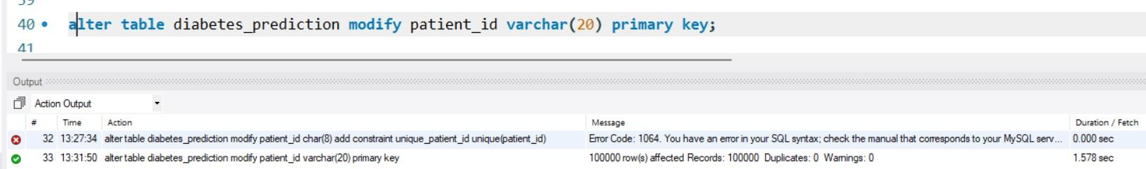
Define a unique constraint on the "patient_id" column to ensure its values are unique.

Slide 18
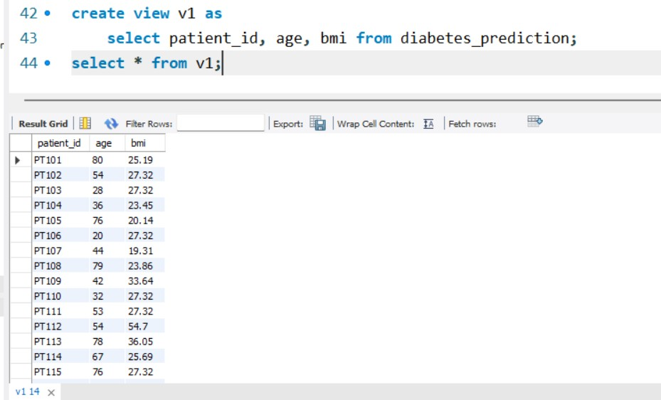
Create a view that displays the Patient_ids, ages, and BMI of patients.

